Slide 1
The Year in Review
2018/2019

Slide 2
OUR VISION
Supporting a strong, healthy,
and well-balanced family unit throughout the various stages of the family life cycle.

Slide 3
Our MISSION
The Muslim Family Foundation (MFF)
is a non-profit community-based organization
that provides programs to assist families and individuals with issues that challenge their mental, physical, and emotional wellbeing. Our programs support basic life skills and provide psychological support as well as family, marriage, and end of life counseling.

Slide 4
Our Story
Muslim Family Foundation (MFF) was founded in 2012 and became a 501 (c) (3) non-profit organization in 2015. MFF is a full social service organization that primarily, but not exclusively, serves the needs of the Inland Empire Muslim Communities.

Slide 5
Our Programs
Mobile Health Clinic
Referral Program
Education and Training
Annual Family Symposium

Slide 6
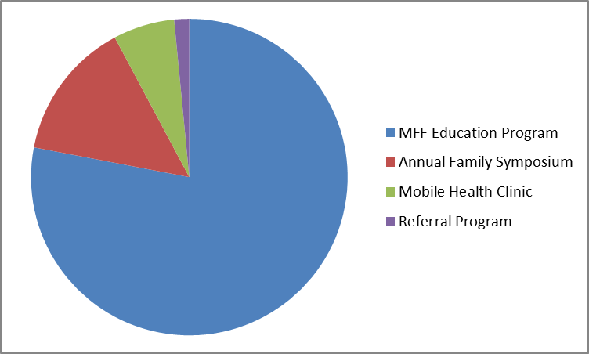
Our Programs

Slide 7
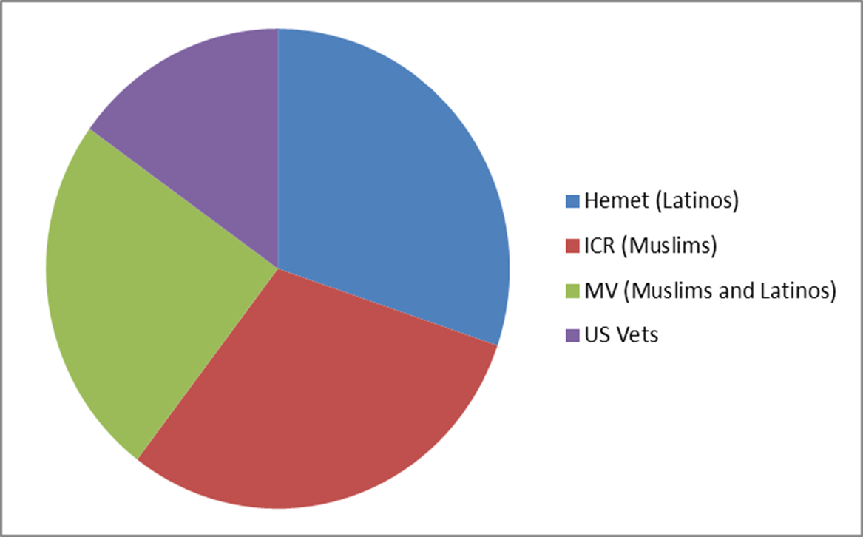
Mobile Health Clinic
Who are we impacting?

Slide 8
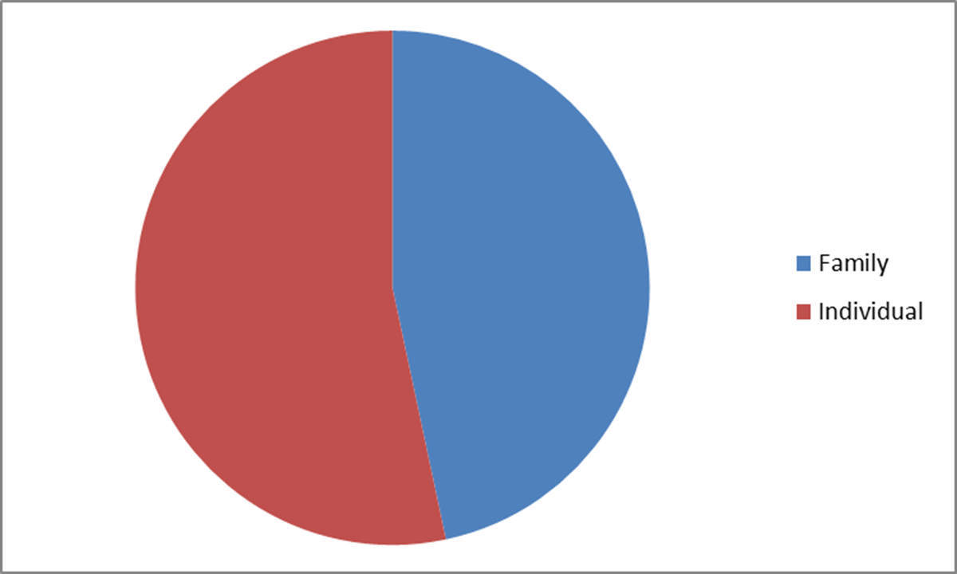
Referral Program

Slide 9
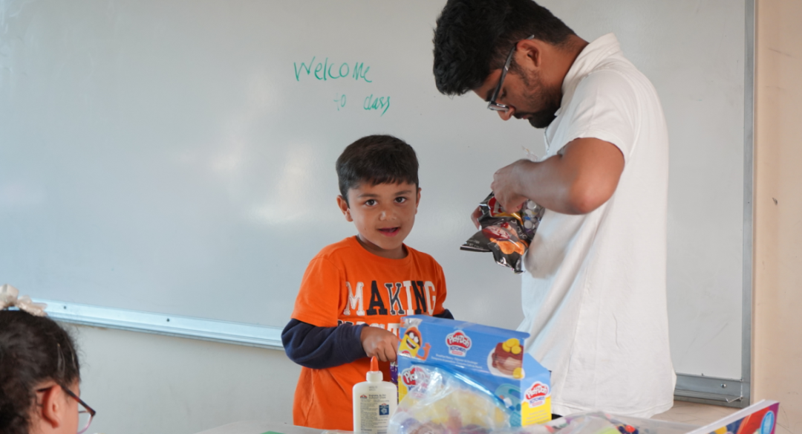
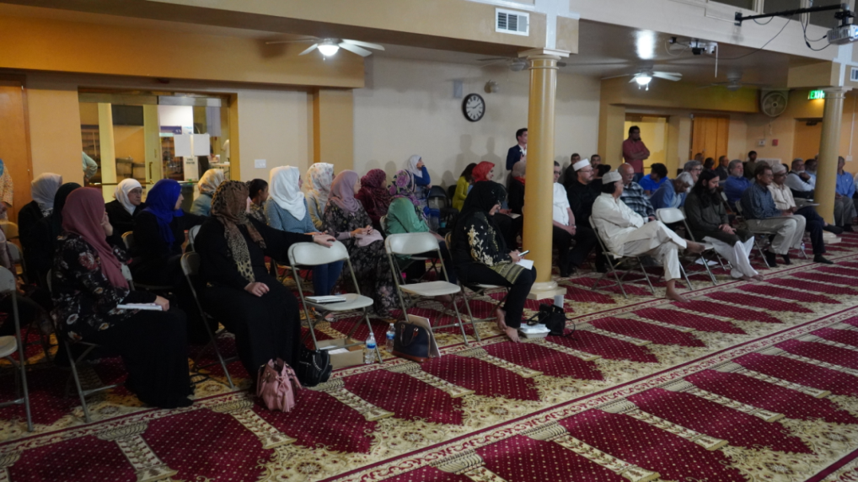
6th Annual Family Symposium

Slide 10
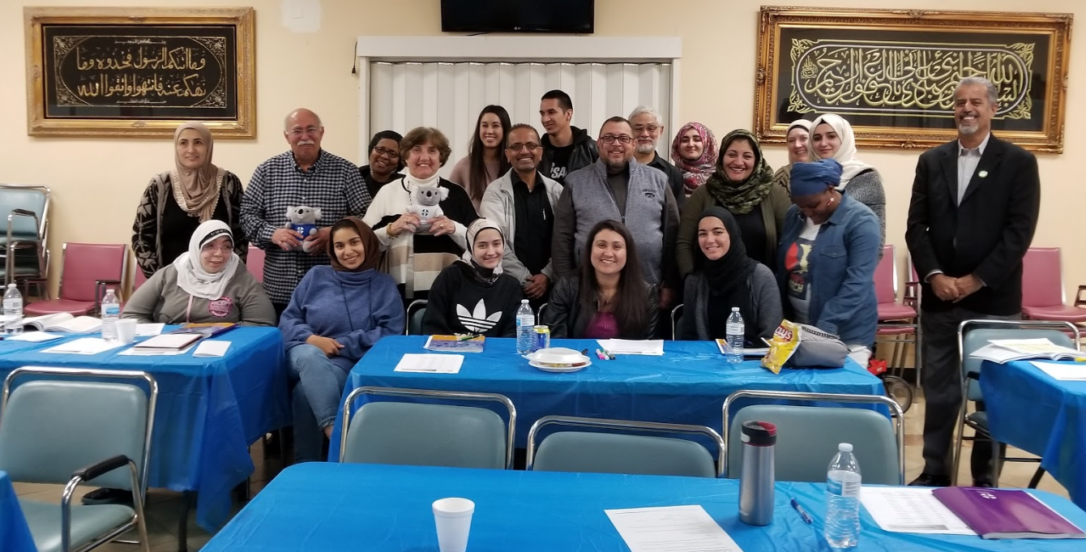
Education and Training: First Aid Mental Health

Slide 11
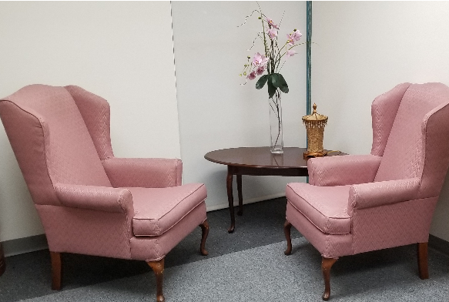
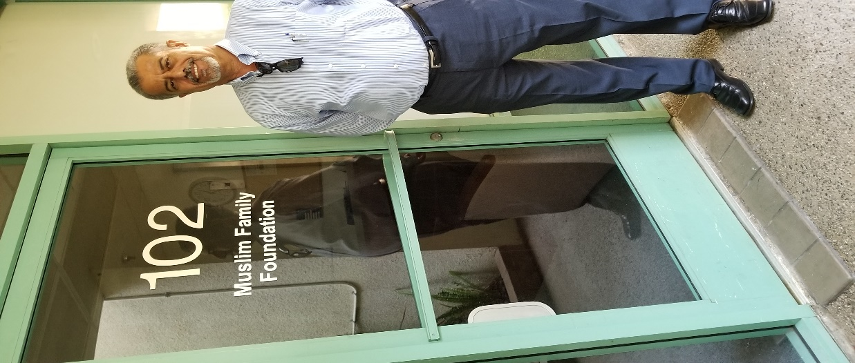
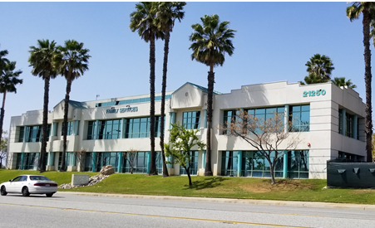
With the help of our partners, donors and supporters, on October 6, 2018 we celebrated the grand opening of the MFF office. The office is located in the County of Riverside, in the City of Moreno Valley, at the beautiful building of the Family Service Association (FSA).
MFF Office Grand Opening
This was one of our 2018 goals.

Slide 12
Our Financials and Awards

Slide 13
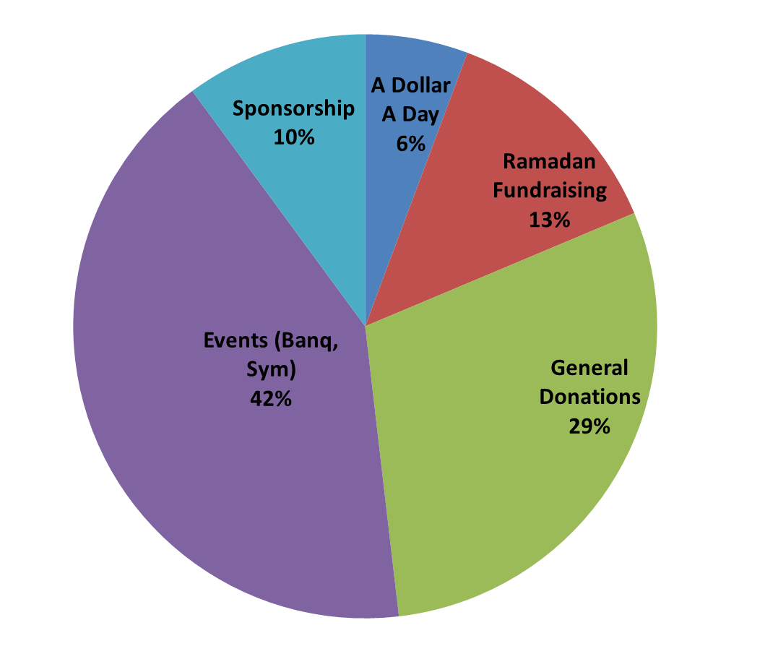
Our Revenue

Slide 14
Awards in 2018/19

Slide 15
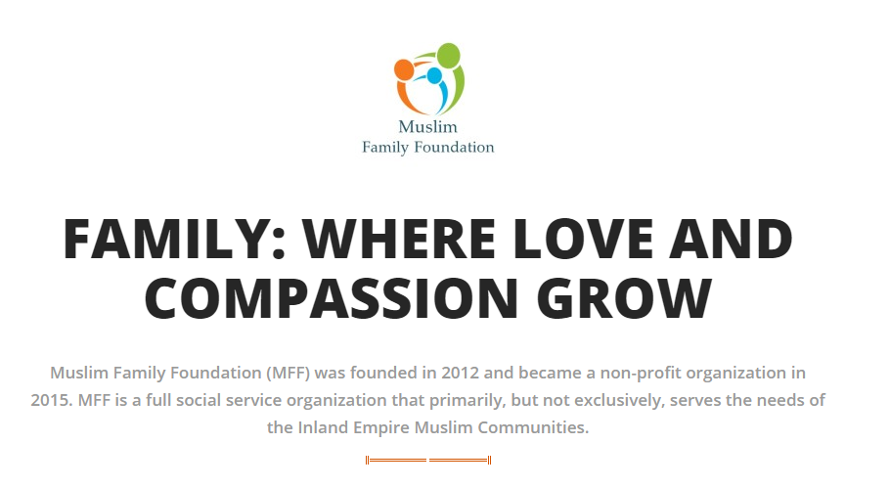
Get Involved with MFF

